Slide 1
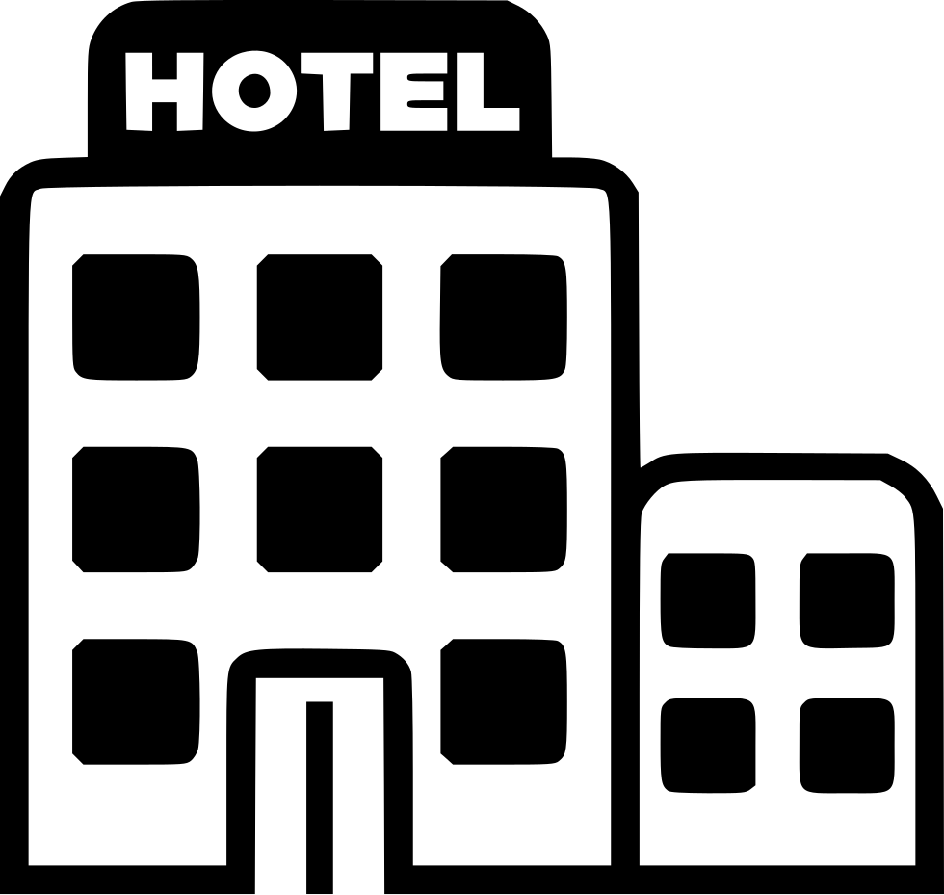
INSY 5339 – Principles of data mining
Improving hotel reservation using predictive analytics
Submitted by:
Group 5
Professor:
Dr. Riyaz Sikora

Slide 2




Hotel Industry facts
Of the 148 million online travel bookings in 2018, 82% occurred without any human interaction, via mobile app or website.
The current growth rate of the online travel sales market is 15.4%, and online hotel bookings are growing at 10.3%.
According to Google , the most popular day for bookings is Monday, and Saturday is the least popular. The same survey showed that most bookings happen around 10 am, while 6 am is the quietest time for bookings.
The online travel booking segment is one of the largest in the travel industry. The travel industry is estimated to be worth around $1.2 trillion annually, and the online booking market makes up 63% of that, or roughly $756 billion.

Slide 3




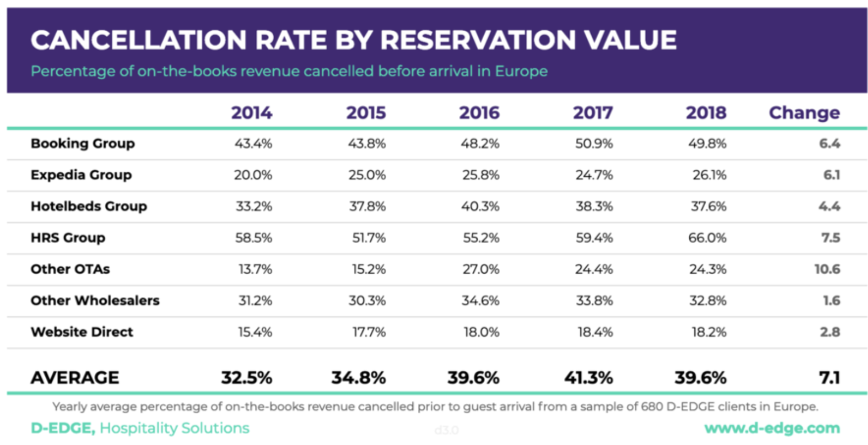
Business Problem
The hospitality industry has witnessed a significant transformation in customer behavior and booking patterns due to the emergence of online hotel reservation channels. However, this convenience has also led to a rise in reservation cancellations and no-shows, posing a challenge for hotel owners.
Almost 40% of on-the-books revenue is canceled before arrival in 2018.
Reservations with lead times longer than 60 days are 65% more likely to be canceled
Hotel room cancellations hurt the entire value chain of the travel industry: the customer paying the cancellation fees, the travel agent losing his/her commission, and the hotel that is losing potential 30% extra income in Food & Beverage and Amenity purchases from the hotel guest

Slide 4
OBJECTIVE
The primary objective of our project is to develop a machine learning model that can accurately predict whether a customer will honor their hotel reservation or cancel it. By analyzing the dataset, we aim to identify the factors that influence reservation cancellations. This predictive model will enable hotel owners to proactively manage their resources, optimize revenue management strategies, and enhance customer service by better understanding customer booking behavior.
Dynamic Pricing: Real-time pricing adjustments for optimal revenue or price match revenue for people who are likely to cancel.
Enhancing Customer Experience: Accurate predictions lead to personalized service and higher guest satisfaction.
Marketing and Promotions: Targeted marketing for potential non-cancellations.

Slide 5
DATA Description
Source of Dataset : Reservation Cancellation Prediction | Kaggle contains 18 columns and 18,137 entries.
Variable Name | Description | Unique Values
Booking_ID | Unique identifier of each booking | Unique
No of adults | Number of adults in the reservation | [0 ,1 ,2 ,3 ,4, 7]
No of children | Number of children in the reservation | [0, 1, 2, 9, 3]
No of weekend nights | Number of weekend nights (Saturday or Sunday) the guest stayed/booked | [0-7]
No of week nights | Number of week nights (Monday to Friday) the guest stayed/booked | [0-16]
Type of meal plan | Meal plan booked by the customer | [0, 1, 2, 3]
Required car parking space | Indicator of whether the customer requires a car parking space | [0, 1]
Room type reserved | Type of room reserved by the customer | [0-6]
Lead time | Number of days between booking date and arrival date | [0 – 500]
Arrival year | Year of the arrival date | [2017, 2018]
Arrival month | Month of the arrival date | [1-12]
Arrival date | Date of the month | [1-31]
Market segment type | Market segment designation | [1, 0, 2, 4, 3]
Repeated guest | Indicator of whether the customer is a repeated guest | [0, 1]
No of previous cancellations | Number of previous bookings canceled by the customer | [0, 1, 11, 3, 2, 4, 5, 13, 6]
No of previous bookings not canceled | Number of previous bookings not canceled by the customer | [0 - 51]
No of special requests | Total number of special requests made by the customer | [ 0, 1, 2, 3, 4, 5]
Booking status (Target variable) | Flag indicating if the booking was canceled or not | [0, 1]
Notes:
It comprises various numerical features, such as the number of adults, children, weekend nights, week nights, lead time, average price per room, and categorical features like meal plan type, car parking space requirement, room type reserved, market segment designation, repeated guest and booking status.

Slide 6
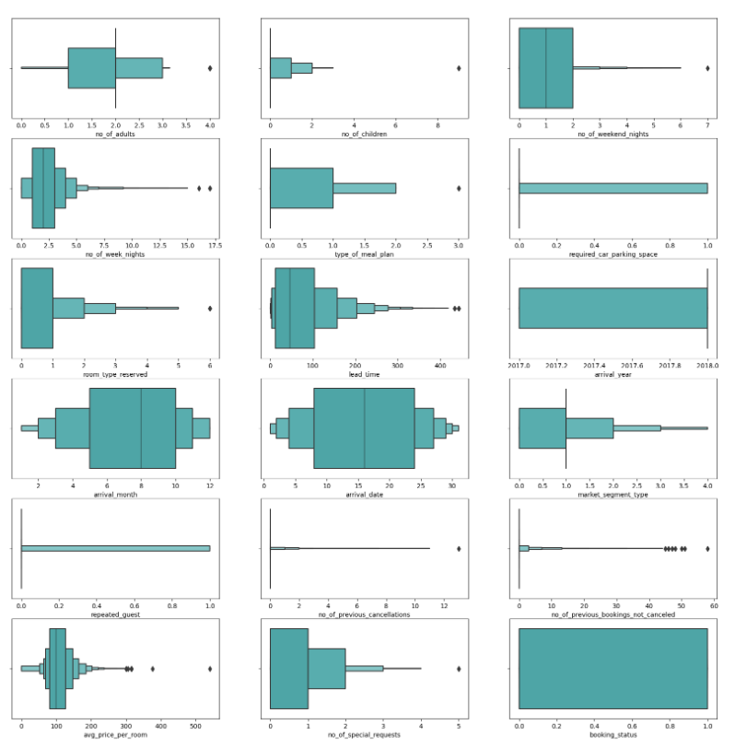
Data pre-processing
Identified unique values, providing an overview of the distinct values present in each column.
Removed rows where both the number of children and adults are zero, resulting in a dataset with non-zero adult or child entries.
Then, duplicate rows are checked and removed, ensuring a clean and deduplicated data frame.
Removing outliers (children = 9 and 3, adults = 7, weekend nights = 6, 7, week nights = 11,12,13,14,15, room_type_reserved = 6, type_of_meal_plan = 3) resulted in 13,983 entries and 18 columns.
Box plots for outliers

Slide 7
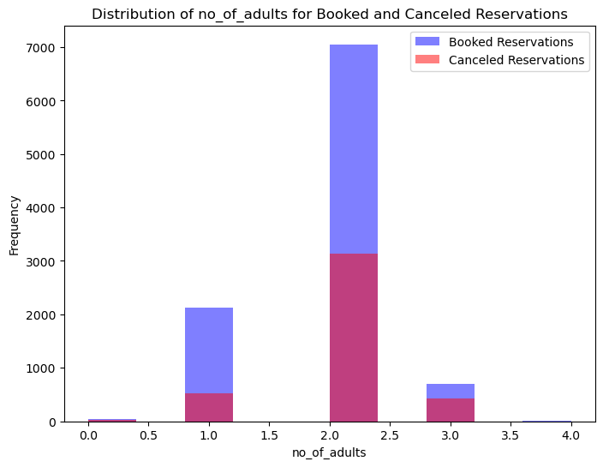
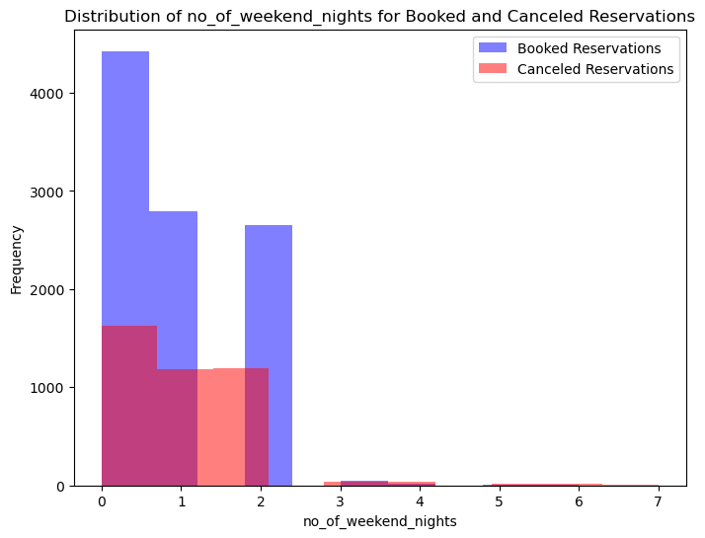
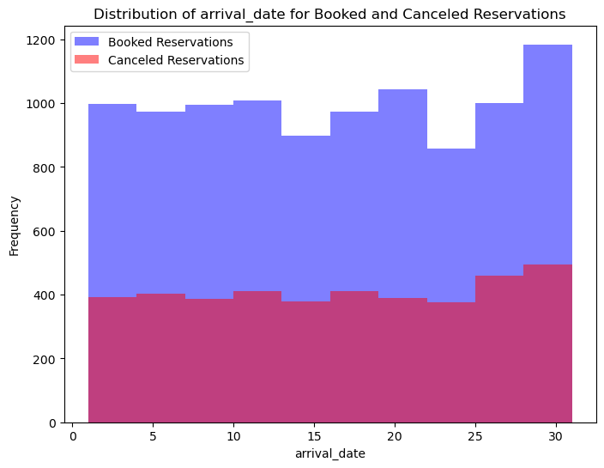
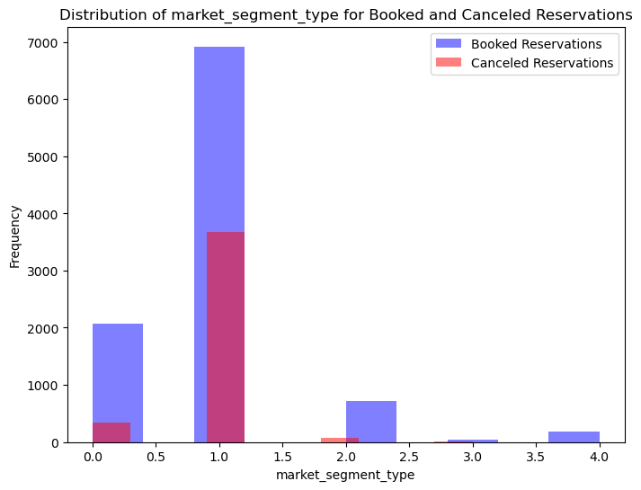
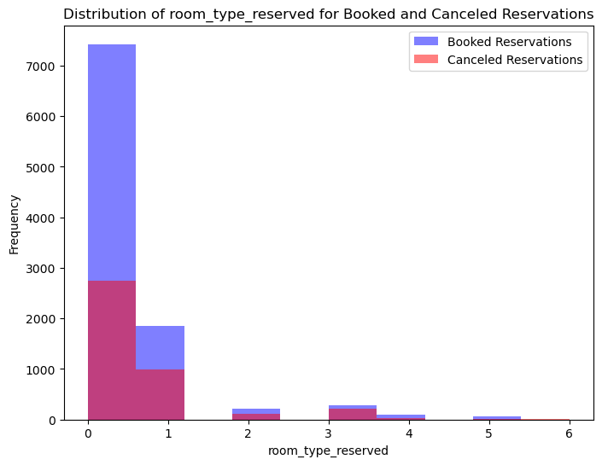
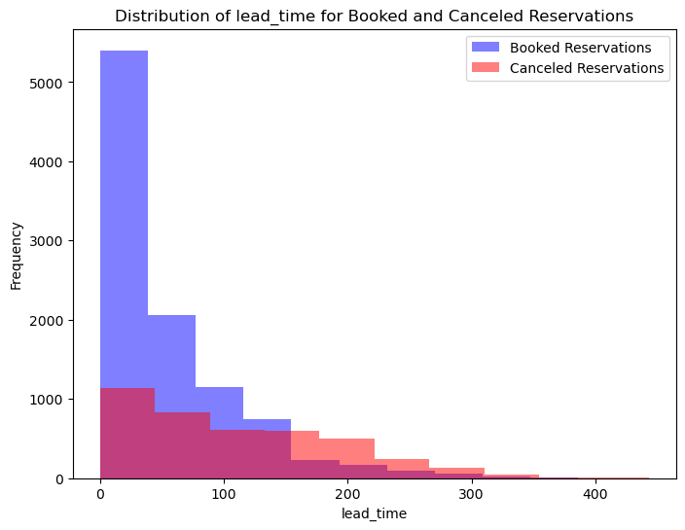
HYPOTHESIS TESTING
Null hypothesis : No difference between booking_status and variables
Alternative hypothesis : Significant difference between booking_status and variables
P-value : 0.128
P-value : 0.06
Fail to reject null hypothesis because p-value is greater than alpha 0.05
Rejected null hypothesis because p-value is less than alpha 0.05
The lack of a significant difference in market segment type and arrival date with booking status suggests that these variables may not be strong predictors of reservation cancellations in the dataset. Other variables which rejected the null hypothesis are the important predictors for reservation cancellation.

Slide 8
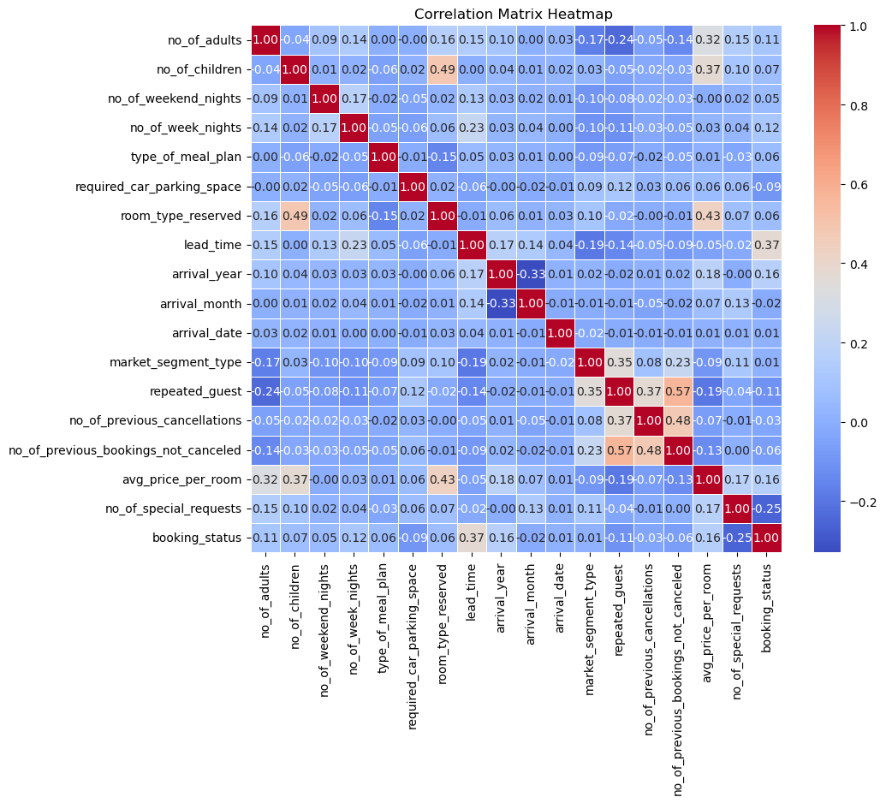
correlation
Positive correlations with booking_status:
1. `no_of_adults` (0.11)
2. `no_of_children` (0.07)
3. `no_of_weekend_nights` (0.05)
4. `no_of_week_nights` (0.12)
5. `type_of_meal_plan` (0.06)
6. `room_type_reserved` (0.06)
7. `lead_time` (0.37)
8. `arrival_year` (0.16)
9. `avg_price_per_room` (0.16)
Negative correlations with booking_status:
1. `required_car_parking_space` (-0.09)
2. `repeated_guest` (-0.11)
3. `no_of_previous_cancellations` (-0.03)
4. `no_of_previous_bookings_not_canceled` (-0.06)
5. `no_of_special_requests` (-0.25)
Weaker correlations with booking_status:
arrival_month (-0.02)
arrival_date (0.01)
market_segment_type (0.01)

Slide 9
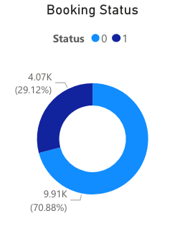
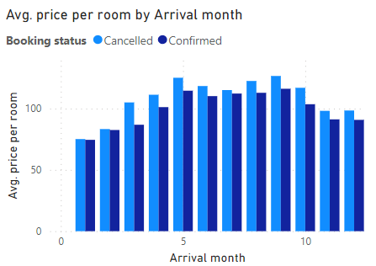
Descriptive analytics
9911 confirmed bookings out of 13,983 bookings
The average room price for the cancelled bookings is higher than the confirmed bookings.

Slide 10
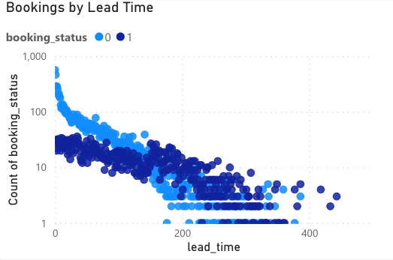
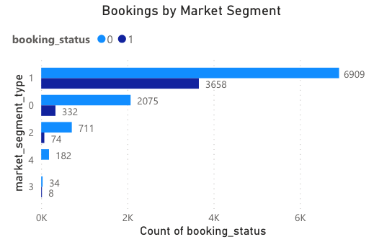
Descriptive analytics
Majority of the confirmed bookings are the ones with lesser lead time/recently made.
Market segment 1 followed by 0 have the most number of cancellations and bookings.
Notes:
Bookings with 0 special requests have more cancellations
atleast 1 special request cancel less
majority bookings are between 5th to 10th month
during which repeated guests are more and they tend to pay more price per room

Slide 11
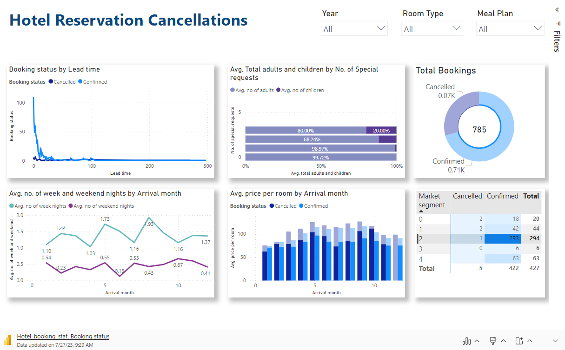
Descriptive analytics
Notes:
https://app.powerbi.com/groups/me/reports/da7e6346-f533-4534-b3ac-c1c88a336cf7/ReportSection?bookmarkGuid=18320e8e-2ce0-4482-aa93-81f58cf6ac02&bookmarkUsage=1&ctid=5cdc5b43-d7be-4caa-8173-729e3b0a62d9&portalSessionId=bc4cbd78-7f21-4cc8-9ee3-3e260df0697c&fromEntryPoint=export
HotelPredictionModel - Power BI

Slide 12
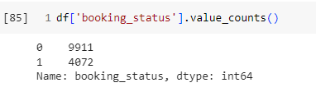
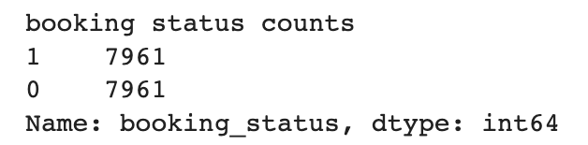
Balancing data using smote
Handled imbalanced data using SMOTE (Synthetic Minority Over-sampling Technique) with the provided data:
The original dataset has 9,911 entries with booking_status = 0 (not canceled) and 4,072 entries with booking_status = 1 (canceled), indicating class imbalance.
After applying SMOTE on training dataset (80% of total dataset), the dataset is balanced, for both booking_status = 0 and booking_status = 1.
SMOTE generates synthetic samples of the minority class (booking_status = 1) to match the majority class (booking_status = 0), effectively increasing the number of canceled bookings to address the imbalance.
The balanced dataset allows for more robust machine learning model training by preventing bias towards the majority class and improving the model's ability to predict both classes accurately.
Before sampling
After sampling

Slide 13
Aim to minimize false negatives
Minimizing False Negatives in hotel booking cancellation prediction is crucial as it reduces the instances where the model incorrectly predicts a booking as "non-cancelled" when it is actually going to be canceled. This ensures that the hotel is better prepared and proactive in handling cancellations, avoiding last-minute surprises.
Predicted
 | Not-Cancelled | Cancelled
Not-Cancelled | True Negative | False Positive
Cancelled | False Negative | True Positive
Actual
By reducing False Negatives, the hotel can allocate resources more efficiently, preventing overbooking and optimizing staff scheduling based on actual booking demands. This leads to cost savings and increased operational efficiency.
Notes:
The confusion matrix represents the performance of a model on a binary classification task (cancelled or not cancelled bookings) and consists of four components:
True Positives (TP): The number of bookings correctly predicted as cancelled.
False Positives (FP): The number of bookings predicted as cancelled but were actually not cancelled.
True Negatives (TN): The number of bookings correctly predicted as not cancelled.
False Negatives (FN): The number of bookings predicted as not cancelled but were actually cancelled.
Let's assume the confusion matrix for our example is as follows:
scssCopy code
Predicted Not Cancelled Predicted Cancelled Actual Not Cancelled 60 (TN) 10 (FP) Actual Cancelled 5 (FN) 25 (TP)
Now, let's calculate the recall for this example:
Recall = TP / (TP + FN) = 25 / (25 + 5) = 0.83
In this example, the recall (true positive rate) is 0.83, which means the model effectively detects 83% of the actual cancelled bookings. However, it misses 5 cancelled bookings (false negatives) out of the total 30 actual cancelled bookings.
Minimizing false negatives is important in scenarios like hotel bookings, where falsely predicting a booking as not cancelled when it actually is cancelled could lead to underbooking, revenue loss and customer dissatisfaction. A high recall (close to 1.0) indicates that the model is effectively identifying most of the cancelled bookings, reducing the risk of false negatives and ensuring that the hotel can manage their capacity more efficiently.

Slide 14
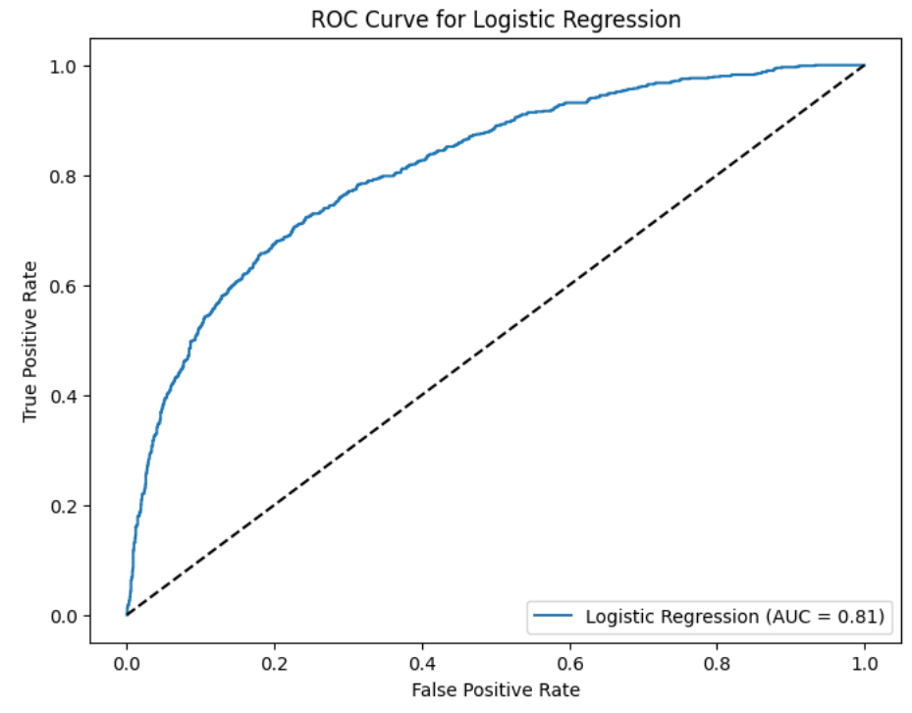
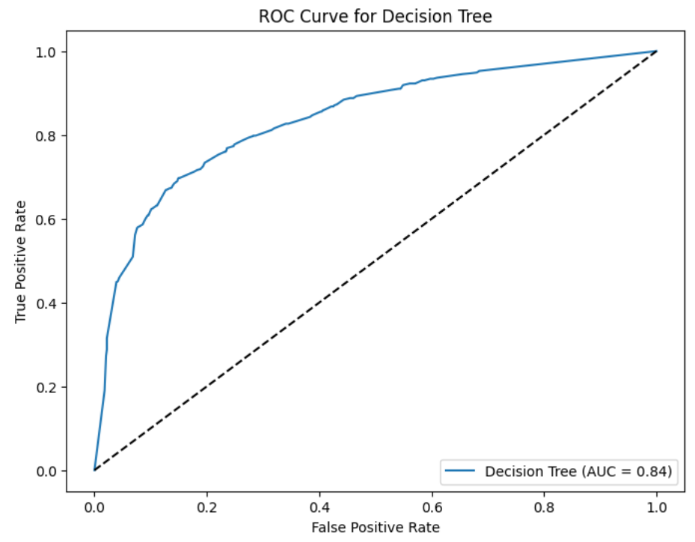
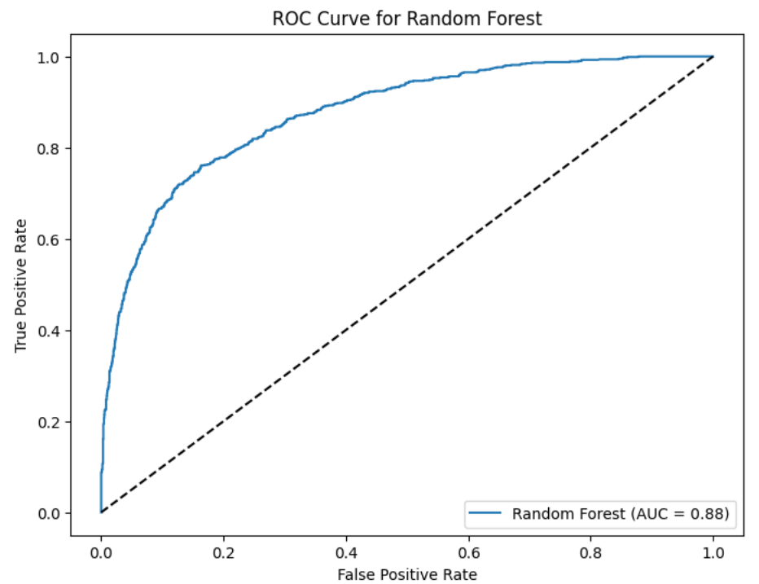
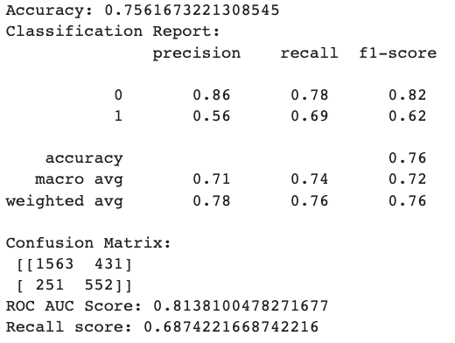
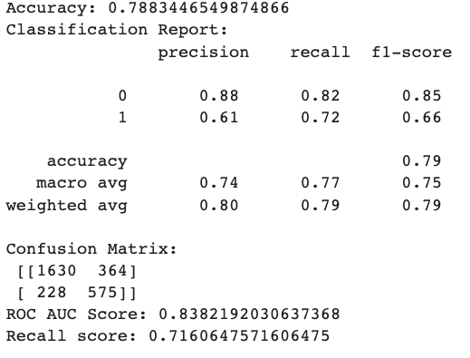
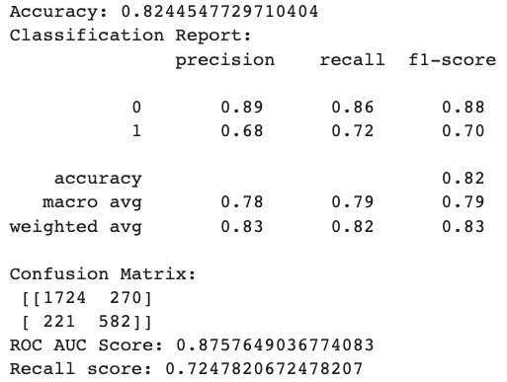
Prediction models
Logistic Regression
Decision Tree
Random Forest
Notes:
Logistic Regression:A linear model used for binary classification, where it estimates the probability of a data point belonging to a certain class (in this case, cancelled or not cancelled).
Decision Tree:A tree-based model that splits data based on features to create a decision-making structure for classification.
Random Forest: An ensemble model that combines multiple decision trees to improve performance and reduce overfitting.
Results: Highest recall (0.72) - effectively detects most cancelled bookings, minimizing false negatives, and achieves the highest AUC score (0.88) and accuracy (82%) among the three models, providing a well-rounded performance.

Slide 15
Results - Comparison of models
Among the three models, the Random Forest model stands out with the highest recall (0.72) - indicating that the model can effectively detect most of the actual cancelled bookings, minimizing the number of false negatives (instances where the model predicted a booking as not cancelled, but it was actually cancelled).
Recall = True positives/Actual positives
ROC curve showing AUC score (0.88), indicates representation of the trade-off between the true positive rate and the false positive rate.
The Random Forest model also achieves the highest accuracy of 82%, providing a well-rounded performance.
Logistic Regression:
Recall: 0.68
AUC Score: 0.81
Accuracy: 75%
Decision Tree:
Recall: 0.71
AUC Score: 0.84
Accuracy: 78%
Random Forest:
Recall: 0.72
AUC Score: 0.88
Accuracy: 82%

Slide 16
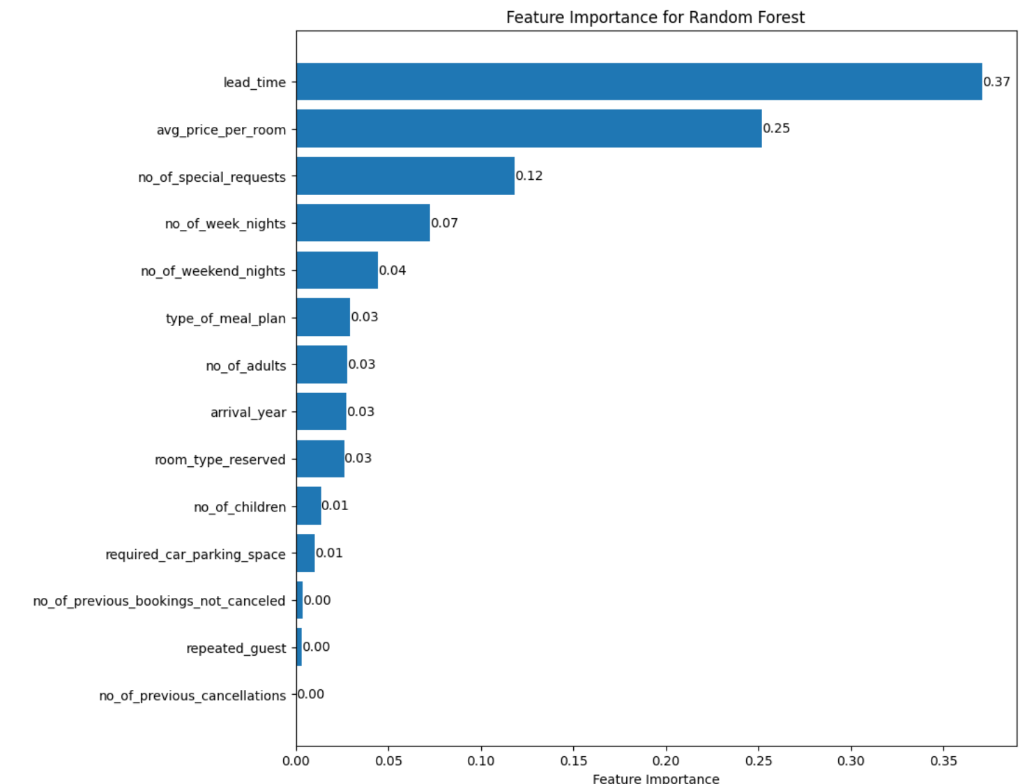
Important features for model
"Lead Time" (Feature Importance: 0.37): The highest importance in predicting booking cancellations. Longer lead times provide customers more time to change their plans or find alternative accommodations, increasing the probability of cancellations.
"Average Price per Room" (Feature Importance: 0.25): Bookings with higher average prices may be more likely to be canceled, possibly due to customers reevaluating their budget or preferences before the actual check-in date.
"Number of Special Requests" (Feature Importance: 0.12): Customers who have specific preferences and requirements may be less likely to cancel if their needs are accommodated, enhancing their overall satisfaction and reducing the chances of last-minute cancellations since this is negatively correlated with booking status.

Slide 17
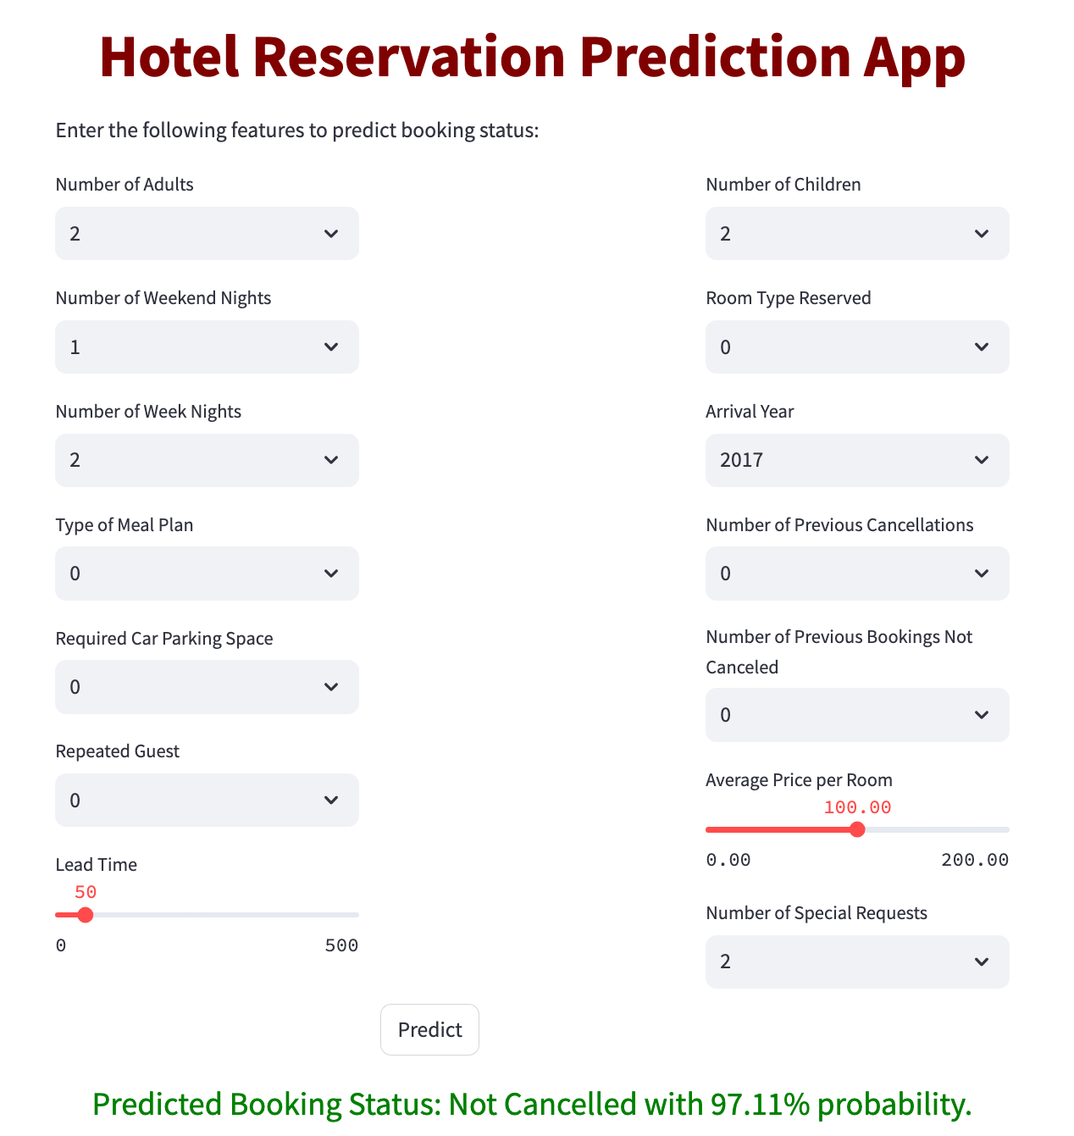
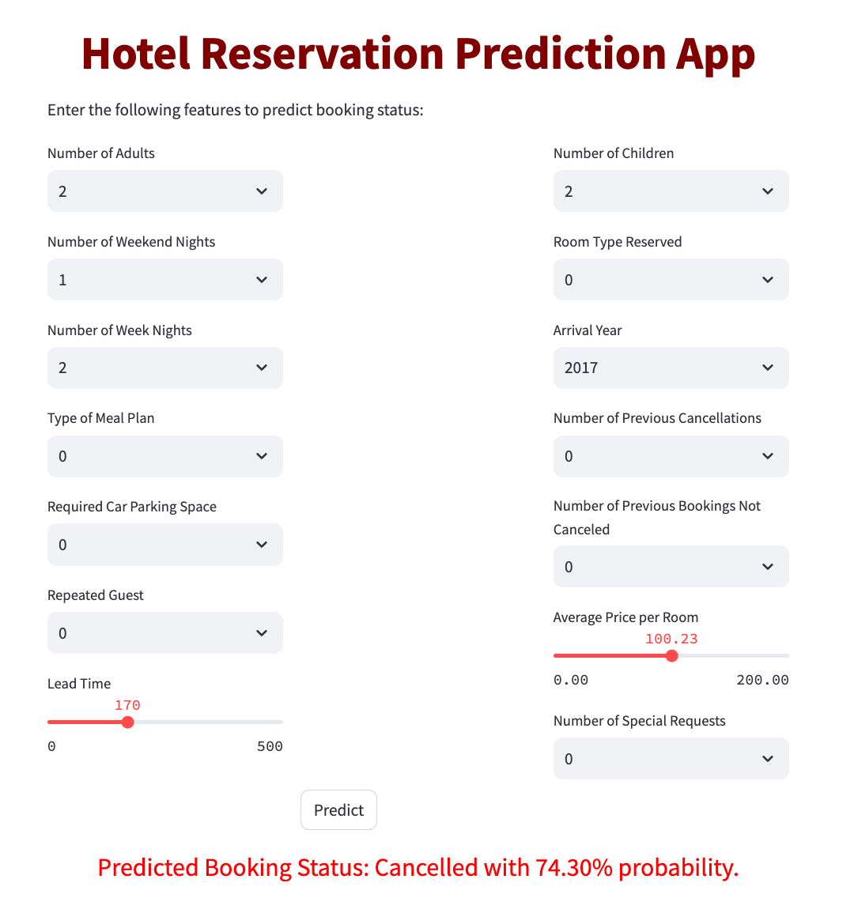
Hotel reservation prediction
app · Streamlit
Notes:
app · Streamlit

Slide 18



suggestions
For customers with a high likelihood of cancellation or longer lead times, the hotel can proactively reach out and offer incentives like price match to retain the booking, such as room upgrades, complimentary services, or exclusive promotions.
For customers who are likely to cancel, hotels can ask them to make non-refundable advance payments at a discounted rate. This approach secures revenue for the hotel while providing cost savings for customers who are committed to their bookings.
To design attractive promotional packages that combine room rates with additional services or amenities. By creating bundled offers, hotels can entice guests to choose comprehensive packages that they are less likely to cancel.

